Slide 1

Topic: Hard Disk Drive
Lecture: Dr. Zhao Jie
Date: 04/22/2026

Slide 2
Reading Assignment
Chapters 37

Slide 3
Agenda
Geometry of a hard disk
Time to access the hard disk
Scheduling of the hard disk

Slide 4
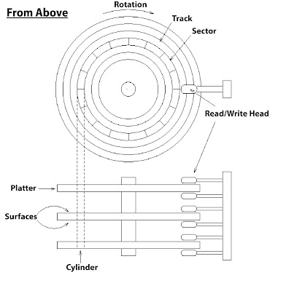
Interface
Combination [1]
Sectors, 512-byte blocks
Address space, [0, n-1]
Atomic execution is either complete in its entirety or won’t be complete at all.
The principle for the design rule
Accessing two blocks in a contiguous chunk is faster than accessing two far-apart blocks.
[1]. https://www.45drives.com/blog/storage/everything-you-need-to-know-about-hard-drive-vibration/

Slide 5
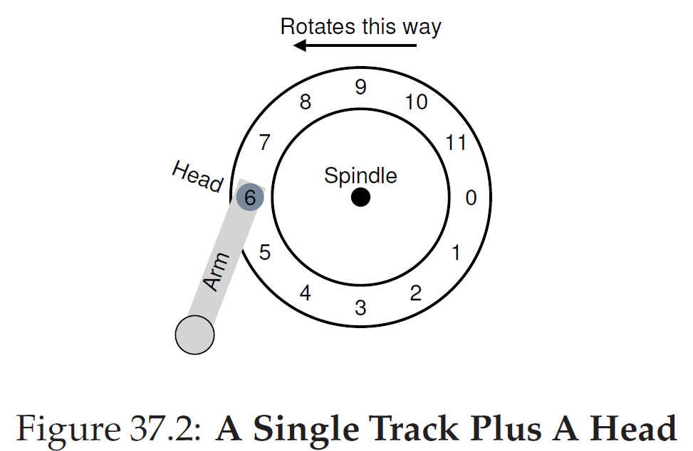
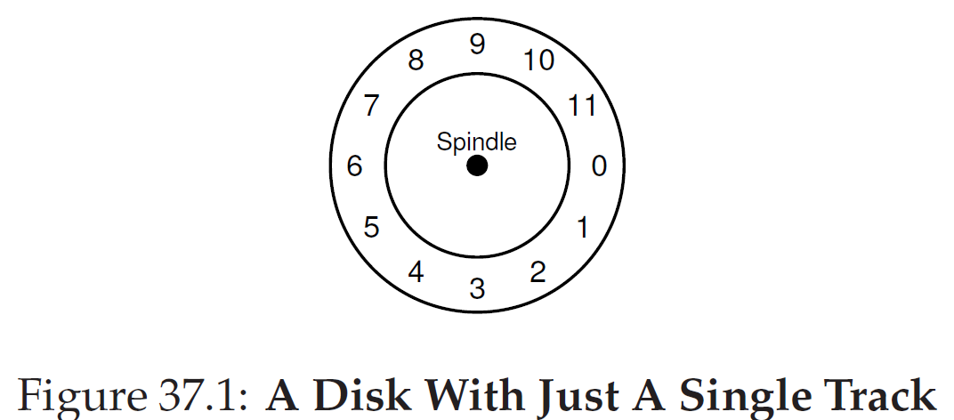
Basic Geometry
Property
RPM (Rotated Per Minute). If rotated at 10K RPM, it will take 6ms.
Read: Senses the magnetic pattern on the disk
Write: Induces a magnetic change.

Slide 6
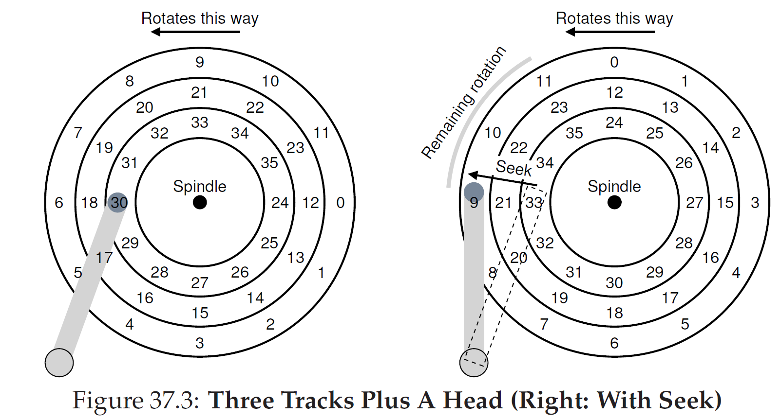
Access to hard disk
Access to the Sector for reading(or writing)
The innermost track(24->35), the next track(12->23), and the outermost track(0->11)
1). Seek: Move the disk arm to the correct track. 2). Waiting for the rotated delay. 3). Data transfer, for reading or writing

Slide 7
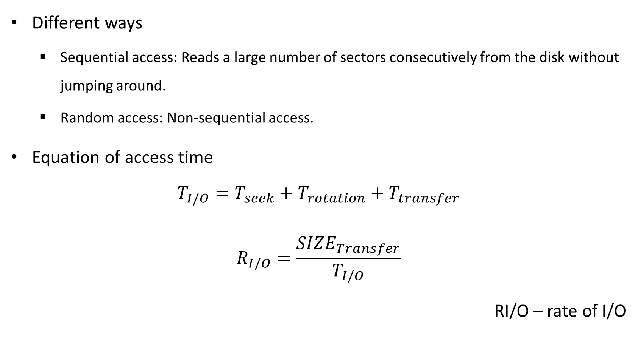
Time to access the hard disk - 1
Different ways
Sequential access: Reads a large number of sectors consecutively from the disk without jumping around.
Random access: Non-sequential access.
Equation of access time
$$T_{I/O}=T_{seek}+T_{rotation}+T_{transfer}$$
$$R_{I/O}=\frac{{SIZE}_{Transfer}}{T_{I/O}}$$
RI/O – rate of I/O

Slide 8
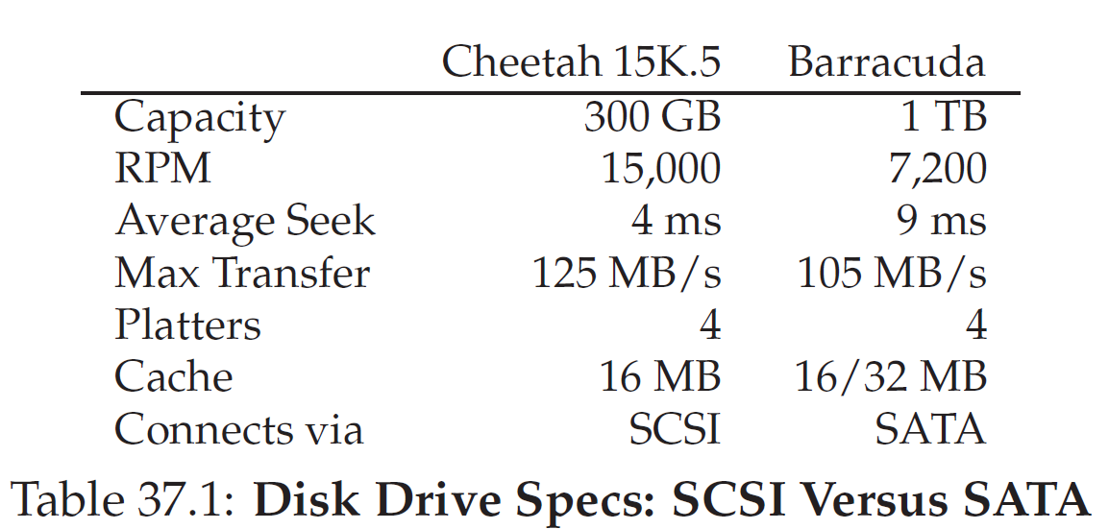
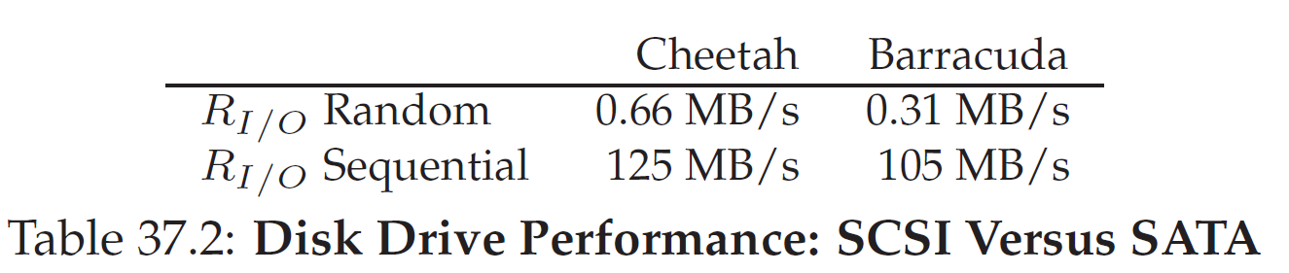
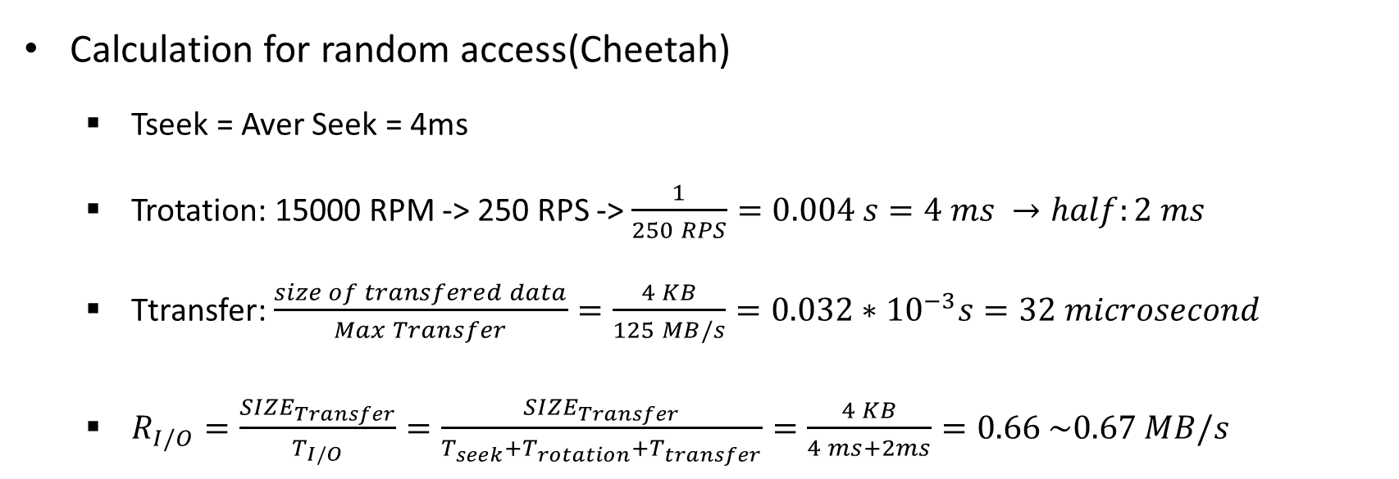
Time to access the hard disk - 2
Calculation for random access(Cheetah)
Tseek = Aver Seek = 4ms
Trotation: 15000 RPM -> 250 RPS -> $\frac{1}{250 RPS}=0.004 s=4 ms →half:2 ms$
Ttransfer: $\frac{size of transfered data}{Max Transfer}=\frac{4 KB}{125 MB/s}=0.032∗{10}^{−3}s=32 microsecond$
$R_{I/O}=\frac{{SIZE}_{Transfer}}{T_{I/O}}=\frac{{SIZE}_{Transfer}}{T_{seek}+T_{rotation}+T_{transfer}}=\frac{4 KB}{4 ms+2ms}=0.66 \sim 0.67 MB/s$

Slide 9
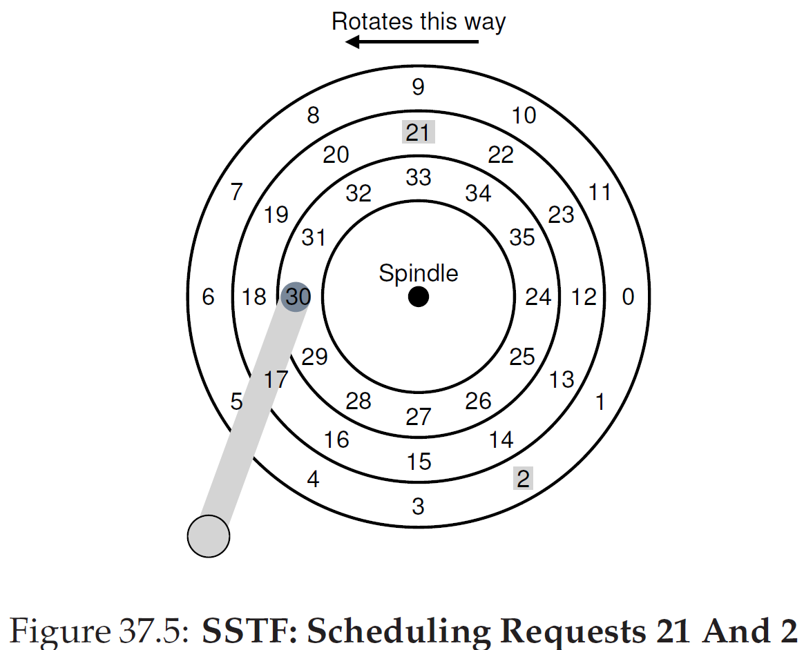
Disk scheduling: First Come First Service (FCFS) and Shortest Seek Time First (SSTF)
Pick up the request on the nearest track(innermost, the next and outermost tracks)
Go to 21 first and then go to 2.

Slide 10
Disk scheduling: Elevator
SCAN
Move back and forth across the disk servicing requests across the tracks. SWEEP: single direction(from the inner to outer tracks; Or opposite)
F-SCAN
Freezes the queue when doing SWEEP.
C(circular) SCAN
SWEEPs from the outer to the inner and then resets at the outer track to begin again.
Elevator
Servicing is based on which floor is closer. For example, when there are requests for 3 and 4, service 4 first because the floor is from 10 to 1.

Slide 11
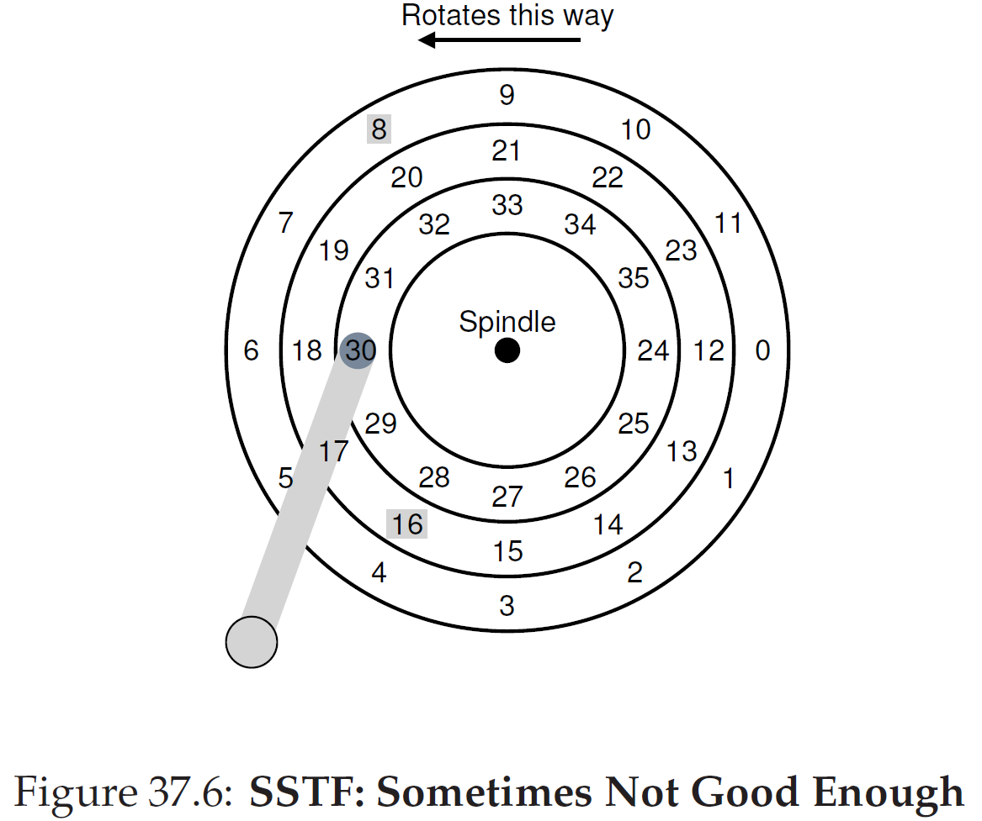
Disk scheduling: Shortest Positioning Time First
Weight seek time and rotation delay.
Which one is faster, pick up it first.

